Slide 1
hITTITE

Slide 2
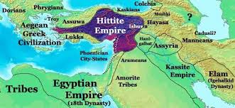
The Hittites were an ancient Anatolian (modern-day Turkey) people who formed an empire between 1600-1180 BCE.
The Hittites manufactures advanced iron goods, ruled over their kingdoms through government officials with independent authority over various branches of government, and worshipped storm gods.

Slide 3
RELIGION

Slide 4
Storm gods were prominent in the Hittites pantheon- the set of all the gods in the polytheistic religions. Tarhunt was referred to as the Conqueror, The King of Kummiya as King of Heaven, and Lord of the Land is Lord Hatti. This might indicate that the Hittites placed value on military might.

Slide 5
Most of what we know about the Hittites comes from their own writings, uncovered from the archaeological digs. These texts provide us with a look into the government records, history, and religious beliefs. We also gain evidence of their religion from unearthing temples and shrines. This is how the kingdom got its nickname from archaeologists.
The following is a list of the main deities that appeared most often in the Hittites mythology.
-Istanu
-Lalwani
-Hanwasuit
-Tarhun
-kumarbi
-Shayshak
-Hannahannah

Slide 6
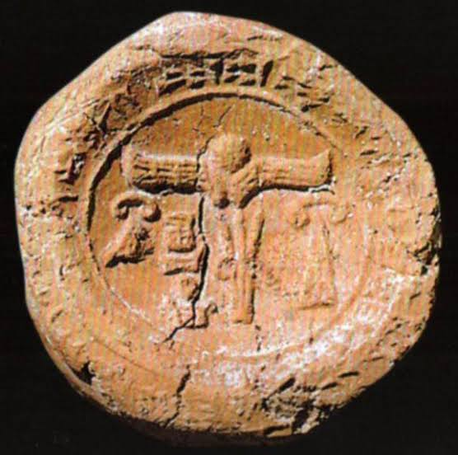
A seal impression from a stamp seal, found in an MM 1 or 11 deposit at Phaistos Crete. Stamped into the clay, the impression is oval and portrays two antithetical lions posed with a leaf motif between their heads. Good parallels for this scene and type seal impression come from Karahoyuk in central Anatolian origin for the seal used is thus very possible, but it may be of pre-hittite manufacture.

Slide 7
First Northern Mesopotamia during the 6th millennium and were exclusively used throughout the ancient Near East until the innovation os the cylinder seals in the second half of the 4th millennium BC.

Slide 8
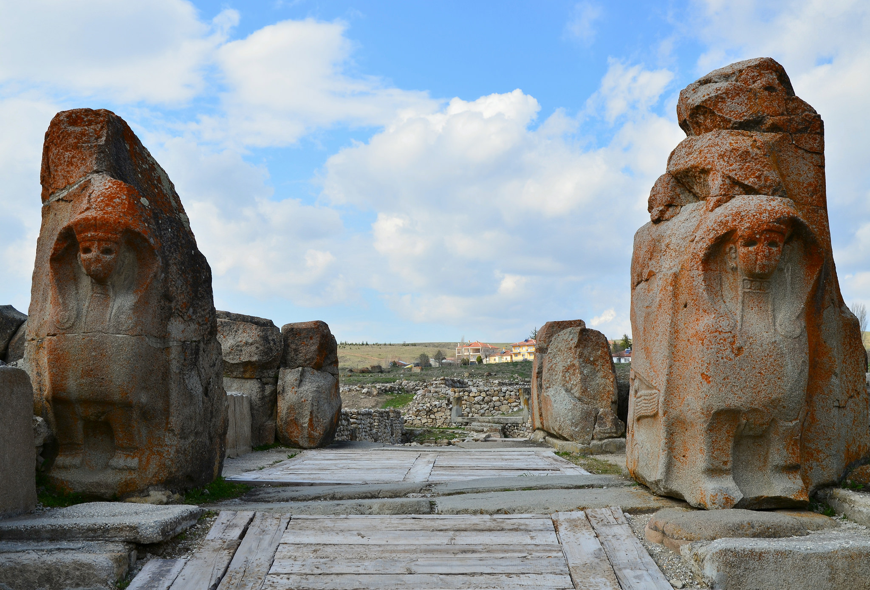
The Sphinx Gate in Hattusa (capital of the Hittite Empire) was part of the city’s fortifications. All four doors jambs of the gate bore representations of Sphinx. Only one original Sphinx is still place while two other are kept in the local museum. Restoration to Germany in 1917. The better-preserved was returned to Turkey in 1924 and placed on display in the Istanbul Archaeology Museum, but the other remained in Germany where it was on display at the Pergamon Museum from 1934, despite numerous requests for its return.

Slide 9
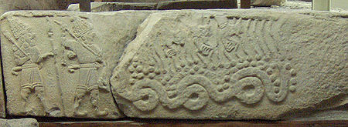
A serpentine or steatite sphinx statuette was found in a late MM III or early LM 1 tomb context at Ayia Triadha, Crete. Small, couchant and wingless, with a large circular depression in the center of its back, this statuette has been the subject of much debate, both in terms of its uses and its origin.

Slide 10
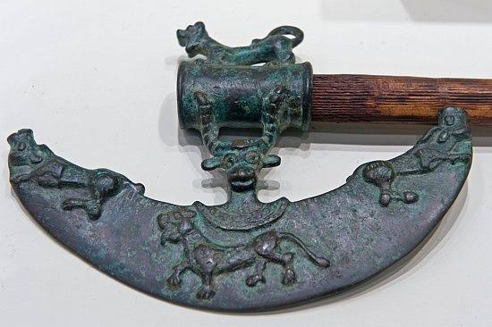
The secret of iron had been revealed to Hittites, a power in the ancient North-East around 1500BC. The Hittite legend is not entirely false, since they are credited with the "discovery" or development of iron technology. Iron probably was not the mythical secret weapon which explained Hittite military success. However, they did develop a smelting process capable of producing iron tools, weapons, and ornamental objects. Their process was the result of years of metal-working experience, not simply an accidental byproduct of an iron rock falling into a fire.

Slide 11
LAW

Slide 12
In the change from the Old to the New Kingdom, the Hittite monarchy turned into a constitutional monarchy, (a government with a main ruler who has constraints to his/her power through a constitution.) which was probably the first constitutional monarchy in the world.The king had the nobility called Panku or “assembly” to whom he delighted duties.
The Hittite empire was quite well-developed and had a well-established law code, even having distinctions between accidental and intentional breaches of law. Most of the laws are causative laws, which are laws that set up a cause-and-effect situation.

Slide 13
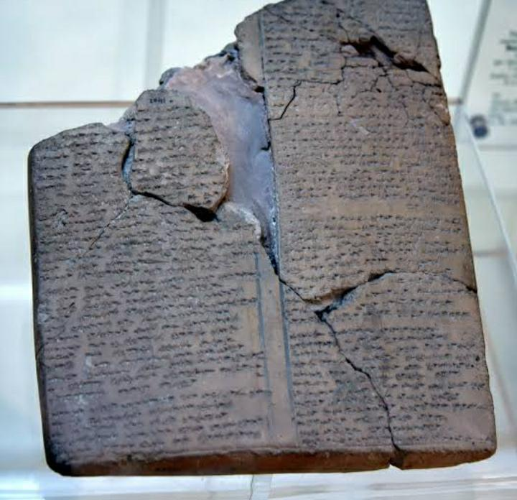
The Hittite laws have been preserved on a number of Hittite cuneiform tablets found at Hattusa [Near Modern Turkey ]
It was written on clay tablets with blunt reed for stylus.
Mostly the type of laws mentioned are civil and criminal.
These codes have been written in Akkardian, Hittite and Sumerian.
According to Prof. Harry A Hoffer Jr. who researched the source of the code is the Old Hittites.
The time period is from c.a. 1500 [O.H.] - c.a. 1180 [N.H.]

Slide 14
THANK YOU

Slide 15
By
-Khushi Shah
-Navya Sogani
-Dhanvi Desai
-Vaibhavi Venkat
-Aayushree Sharma
-Kunal Rane
-Aishwarya Mukim

